Slide 1
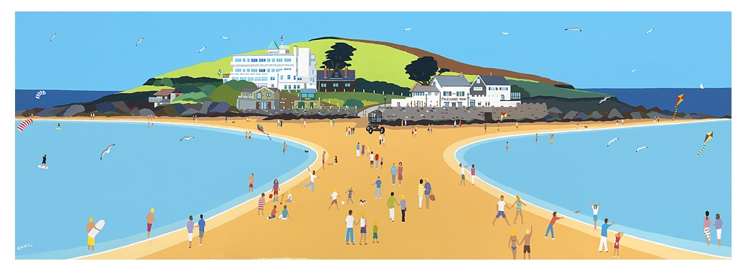
Burgh Island

Slide 2
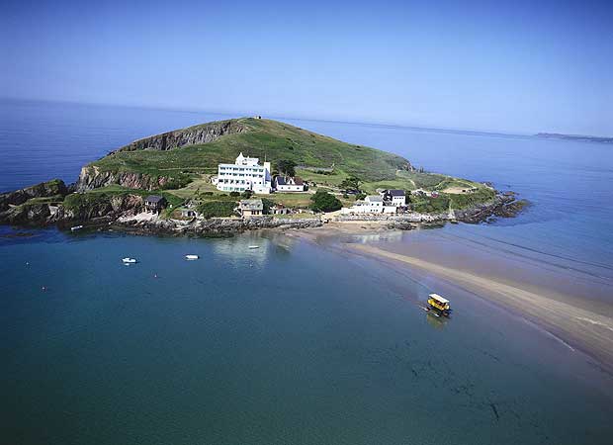

Slide 3
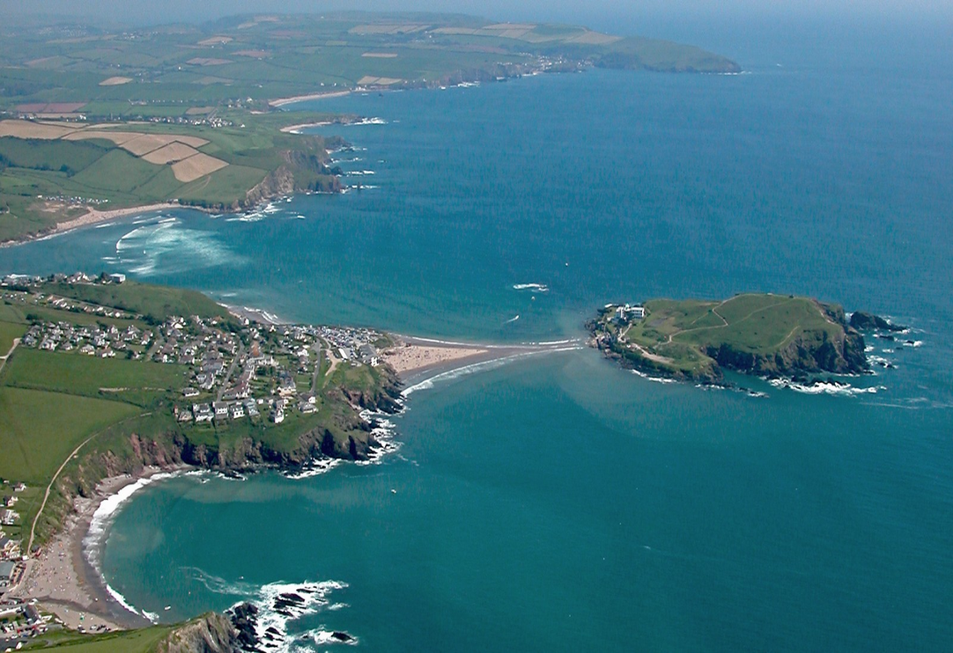
Burgh Island
is a small island off the south coast of Devon in England near to the small seaside village of Big bury on Sea.

Slide 4
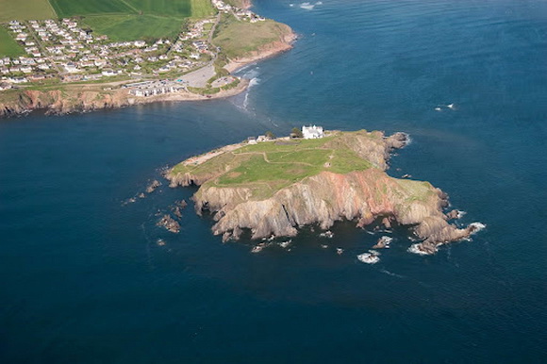

Slide 5
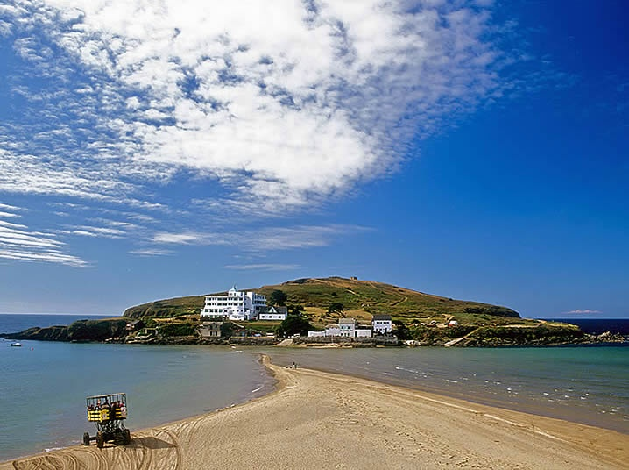
There are only two buildings of any significance on the island

Slide 6
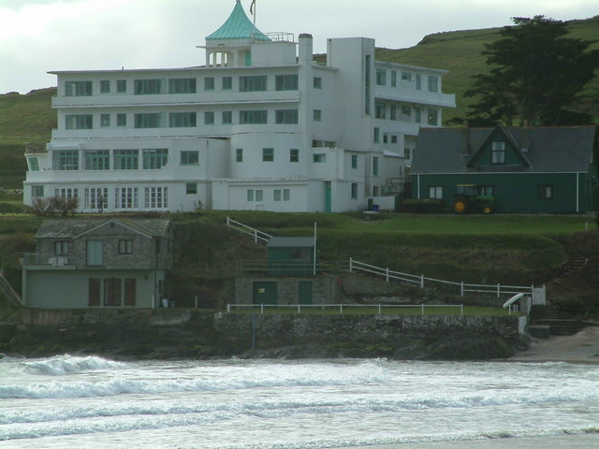
The larger being the Art Deco Burgh Island Hotel

Slide 7
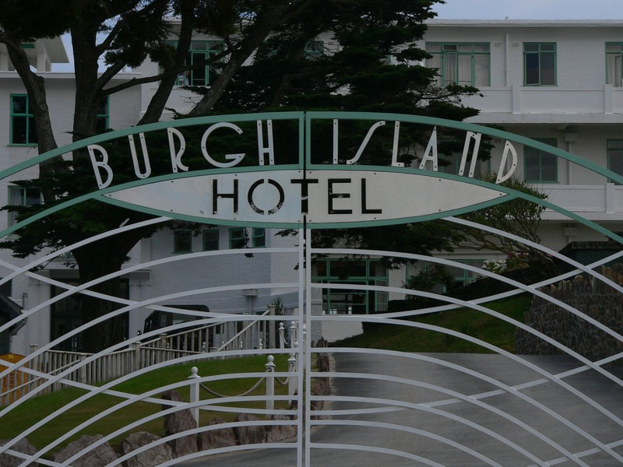

Slide 8
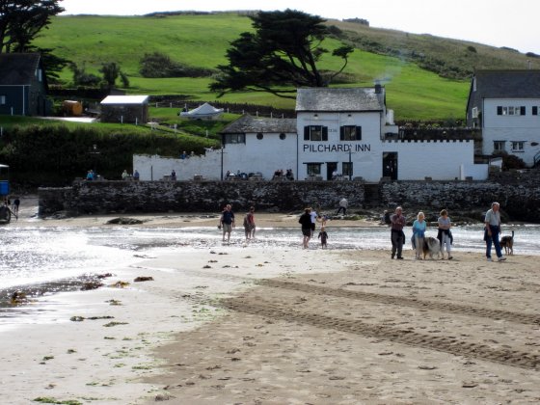
The smaller being a public house, Pilchard Inn.

Slide 9
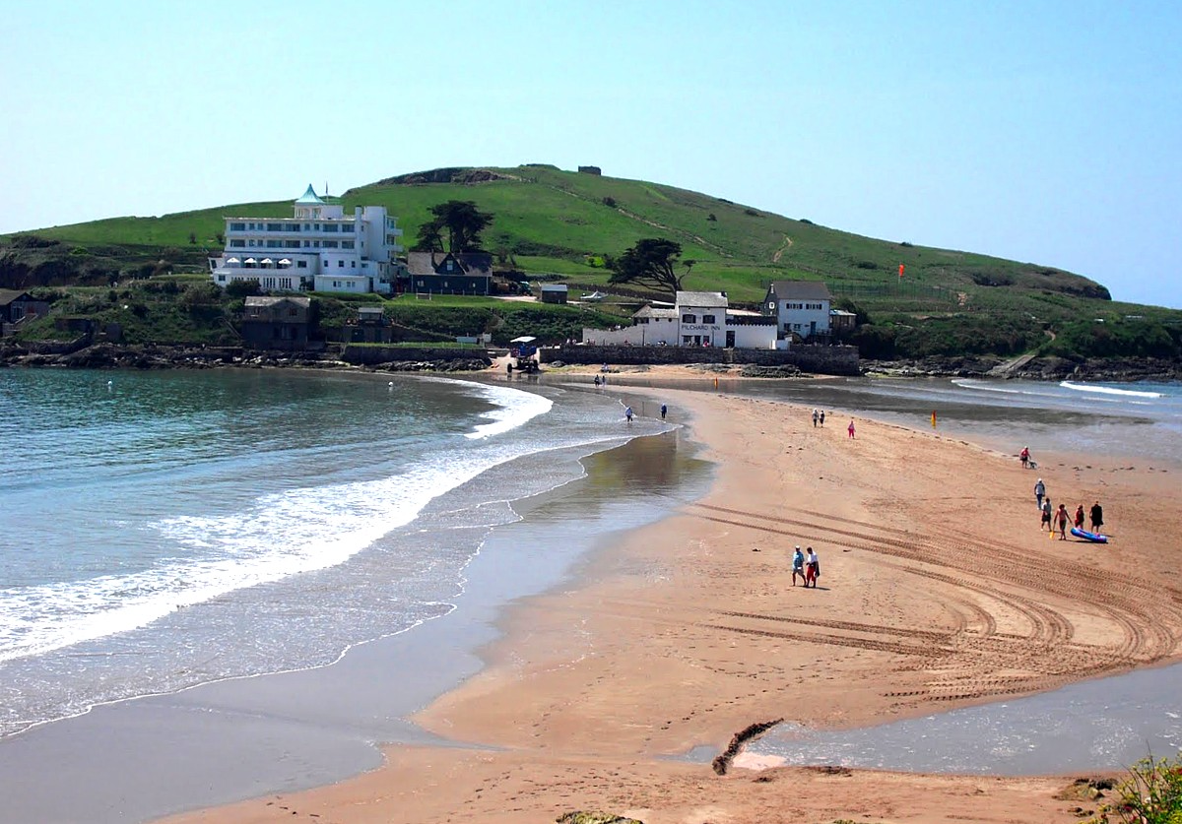
At low tide, the island, only 200 m. from the shore, may be approached on foot

Slide 10
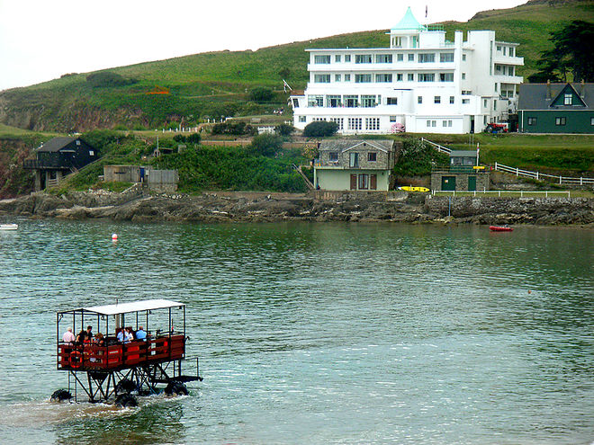
At high tide the Sea Tractor operated by the hotel provides a ferry service.

Slide 11
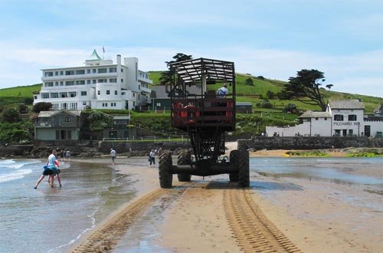
This unusual vehicle, the current one dating from 1966, drives across with its wheels underwater on the sandy bottom and its driver and passengers on a platform high above.

Slide 13
